Slide 1
Design By Contract
TOPIC 4
UTM-SERG Research & Consultancy Team
School of Computing
Faculty of Engineering
Universiti Teknologi Malaysia
UTM, Skudai, Johor.

Slide 2
AGENDA
Agenda 1: Design by contract
Agenda 2: Preconditions
Agenda 3: Exceptions in the contract
Agenda 4: Assertions
Agenda 5: Postconditions
Agenda 6: Invariants
Agenda 7: Contracts and Inheritance
Agenda 8: Defensive programming
Agenda 9: Devops
Agenda 10: Summary

Slide 3
Design by contract
What is meant by "design by contract" or "programming by contract"?
contract: An agreement between classes/objects and their clients about how they will be used.
  used to assure that objects always have valid state
  non-software contracts: bank terms, product warning labels
To ensure every object is valid, show that:
  constructors create only valid objects
  all mutators preserve validity of the object
What is the cost of enforcing a contract?

Slide 4
Example contract issue
A potential problem situation: queue class with remove or dequeue method
  client may try to remove from an empty queue
What are some options for how to handle this?
  declare it as an error (an exception)
  tolerate the error (return null)
  print an error message inside the method
    bad because it should leave this up to the caller
  repair the error in some way (retry, etc.)
    bad because it should leave this up to the caller
The decision we make here becomes part of the contract of the queue class!

Slide 5
Hoare Logic
Purpose: Verification of statements/programs
Central concept: Hoare Triple:
{P} S {Q}
  S is a statement /operation
  P and Q are pre- and post-condition of S
Semantic
  Whenever p holds before running S, and S terminates, then q will hold after running S.
Simple example
  {x = y} y := y - x + 1; {y = 1}

Slide 6
Design by contract
What is a precondition? What happens when a precondition is not met?
precondition: Something that must be true before object promises to do its work.
  Example: A hash map class has a put(key, value) and a get(key) method.
    A precondition of the get method is that the key was not modified since the time you put it into the hash map.
  If precondition is violated, object may choose any action it likes
    If key was modified, the hash map may state that the key/value is not found, even though it is in the map.
  Document preconditions in Javadoc with @pre.condition tag.

Slide 7
Precondition example
Binary search on an array of ints: Java API link
Searches the specified array of ints for the specified value using the binary search algorithm. The array must be sorted (as by the sort method, above) prior to making this call. If it is not sorted, the results are undefined. If the array contains multiple elements with the specified value, there is no guarantee which one will be found.
Q: why doesn't Sun just check whether the array is sorted, and sort it if it isn't? Or why not check whether the array is sorted and throw an exception if it isn't?
  sort is costly (sort takes O(n log n) or worse time; search is O(log n))
  sort modifies the input array; binarySearch would not be read-only
  checking to see whether the array is sorted is costly (isSorted takes O(n)); omitting this check and assuming it to be true makes binary search run much faster

Slide 8
Exceptions in the contract
A precondition is something assumed to be true
(and, as far as the client knows, not checked for by the callee)
  NOT the same thing as throwing an exception on precondition violation
Example: A Stack class has a pop method to remove and return the top element. Making the stack throw an exception when the client calls pop on an empty stack is not a precondition.
  The caller can see that the callee checks for this and has a predictable action when it fails.
  We say instead that the EmptyStackException is part of the contract.
  Document exceptions in Javadoc with @throws tag.

Slide 9
Example exception code
/** Constructs a new account with the given name and password.
* @throws NullPointerException if name or password is null.
* @throws IllegalArgumentException if password has fewer than 6
* characters or fewer than 3 unique characters.
*/
public Account(String name, String password) {
if (name == null || password == null)
throw new NullPointerException();
else if (password.length() < 6 || getUnique(password) < 3)
throw new IllegalArgumentException(password);
this.name = name;
this.password = password;
}
public void setPassword(String password) {
if (password == null)
throw new NullPointerException();
else if (password.length() < 6 || getUnique(password) < 3)
throw new IllegalArgumentException(password);
this.password = password;
}
How could this code be improved?

Slide 10
What makes a precondition?
It must be something testable from the outside.
  Client code should be able to claim that it has met all preconditions before it calls your code.
  Don't make a precondition that can only be verified by using private data.
    Example: a swapTop2 method with a precondition that the Stack's (private int) size >= 2, if client code can only check whether it isEmpty()
Don't make it a precondition if they can't verify it beforehand.
  Bad example: "precondition: file exists and can be read"
    How can the client verify this? It is unpredictable.
    Even if caller does check this, it could be changed when the object tries to read it.

Slide 11
What about other tests?
If an object shouldn't have code that checks whether its preconditions are true (and throw exceptions etc. if not), how do we catch bugs where a client accidentally calls the code with a false precondition?
assertion: A fail-fast way to test for error conditions that should never occur.
  Use assertions to verify preconditions when testing and debugging your code.
  Don't over-rely on assertions;
  they are more commonly used for things that NEVER should happen! Exceptions in the contract are more common.
  When an assertion fails, this is considered an error on the part of the developer and should be fixed immediately.

Slide 12
Assertions in Java
Java assert statements
  assert <condition> ;
  assert <condition> : <message>;
enabling assertions
  when compiling: javac -source 1.5 ClassName.java
  when running: java -ea ClassName
  In C/C++, assert is a compile-time thing.
  In Java, can selectively en/disable assertions at runtime.
  Assertions should NOT be enabled in a shipping product;
  the user gets unfriendly error message, can't fix it or recover.

Slide 13
Example assertion code
Consider int array binary search code:
/** Returns index of value n in array a.
* @pre.condition The array a is in sorted order.
*/
public static void binarySearch(int[] a, int n) {
assert isSorted(a) : "Array must be sorted";
...
}
private static boolean isSorted(int[] a) {
for (int i = 0; i < a.length - 1; i++)
if (a[i] > a[i+1])
return false;
return true;
}

Slide 14
Postconditions
What is a postcondition? Whose fault is it when a postcondition is not met, and what should be done?
postcondition: Something that must be true upon completion of the object's work.
  Example: At end of sort(int[]), the array is in sorted order.
  Check them with statements at end of methods, if needed.
  A postcondition being violated is object's (your) own fault.
  Assert the postcondition, so it crashes if not met.
    Don't throw an exception -- it's not the client's fault!
  Document postconditions in Javadoc with @post.condition

Slide 15
Class invariants
What is a class invariant? How is it enforced?
class invariant: A logical condition that always holds for any object of a class.
  Example: Our account's balance should never be negative.
  Similar to loop invariants, which are statements that must be true on every iteration of a loop.
  Can be tested at start or end of every method.
  Assert your invariants, so it crashes if they are not met
    don't throw an exception -- it's not the client's fault!
  Document class invariants in the Javadoc comment header at the top of the class. (no special tag)

Slide 16
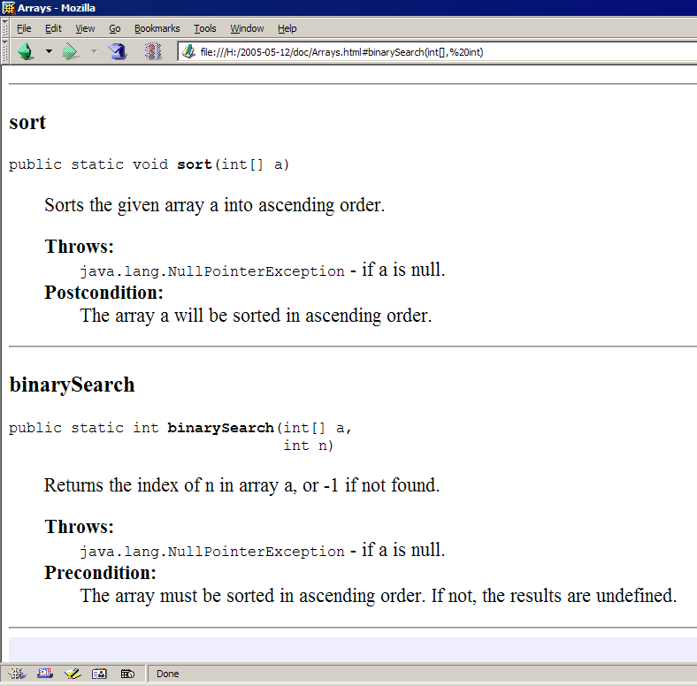
Running Javadoc with tags
javadoc -source 1.5
-d output_folder_name
-tag pre.condition:cm:"Precondition:"
-tag post.condition:cm:"Postcondition:"
file_name.java
Javadoc output will
show pre, postconditions

Slide 17
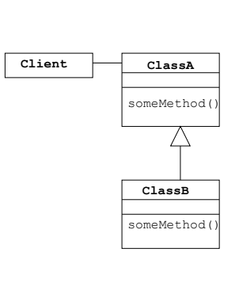
Inheritance: Preconditions
If the precondition of the ClassB.someMethod is stronger than the precondition of the ClassA.someMethod, then this is not fair to the Client
The code for ClassB may have been written after Client was written, so Client has no way of knowing its contractual requirements for ClassB

Slide 18
Inheritance: Postconditions
If the postcondition of the ClassB.someMethod is weaker than the postcondition of the ClassA.someMethod, then this is not fair to the Client
Since Client may not have known about ClassB, it could have relied on the stronger guarantees provided by the ClassA.someMethod

Slide 19
Contracts can not be broken in sub-classes!
Pre- and post-conditions of methods are inherited in redefined methods
  The pre-condition can be weaker
    The method accepts more input cases
    The new pre-condition is combined with previous pre-condition using disjunction (OR)
  The post-condition can be stronger
    The method delivers more specify results
    The new post-condition is combined with previous post-condition using conjunction (AND)
The invariant of the parent class are passed to the derived classes
  Invariants are combined using conjunction

Slide 20
Guidelines
Always check pre-conditions, raising exceptions if they fail! It must be something testable from the outside. Client should be able to claim that it has met all preconditions before it calls the code. Don't make a precondition that can only be verified by using private data.
Every class has its own invariant (declared as protected)!
Check post-conditions and invariants to inform yourself when you violate the contract!
Check post-conditions and invariants whenever the implementation is non-trivial!

Slide 21
Defensive Programming
Robustness
  The degree to which a system or component can function correctly in the presence of invalid inputs or stressful environmental conditions.
Sources of errors
  Erroneous usage
    Wrong input data
  Erroneous environmental conditions
    Disk full
    Network down, etc.
Approach
  We make assumptions which error scenarios are likely to happen!

Slide 22
Defensive Programming
A general approach to programming that assumes that errors will occur during both initial development and maintenance and, as a result, creates code in such a way that the program still operates properly when errors occur IEEE
Every method shall protect itself against (known) errors
Implementation
  We try to handle all possible error scenarios
  Assertions and exception handling
Implication
  A method contains of “functional” code and of “defensive” code!
  The defensive code may be very large!

Slide 23
Protecting Your Program from Invalid Inputs
For production software, garbage in, garbage out isn't good enough.
  A good program never put out garbage, regardless of what it takes in.
  "Garbage in, nothing out"
  "Garbage in, error message out"
  "No garbage allowed in“
Check the values of all data from external sources!
Decide how to handle bad inputs!
  Use error-handling code for conditions you expect to occur
  Use assertions for conditions that should never occur
    To document contracts
  For highly robust code, assert and then handle the error anyway

Slide 24
Correctness vs. Robustness
Correctness
  Never returning an inaccurate result; returning no result is better than returning an inaccurate result.
Robustness
  Always trying to do something that will allow the software to keep operating, even if that leads to results that are inaccurate sometimes.
These terms are at opposite ends of the scale from each other.
  Safety-critical applications tend to favor correctness to robustness!
  Consumer applications tend to favor robustness to correctness!

Slide 25
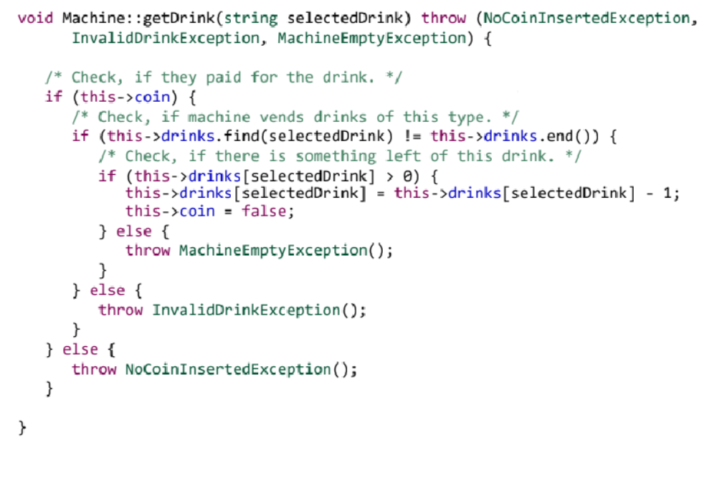
example
Check errors
Exception Handling

Slide 26
Defensive Programming vs. Design by Contract
Defensive programming
  promotes putting checks in every method/module to detect unexpected situations
  results in redundant check (both client and server)
  checks can make the software more complex and harder to maintain
Design by Contract
  The responsibility assignment is clear and part of the interface
    prevents redundant checks
    easier to maintain
    provides a (partial) specification of functionality
Both are needed based on situations

Slide 27
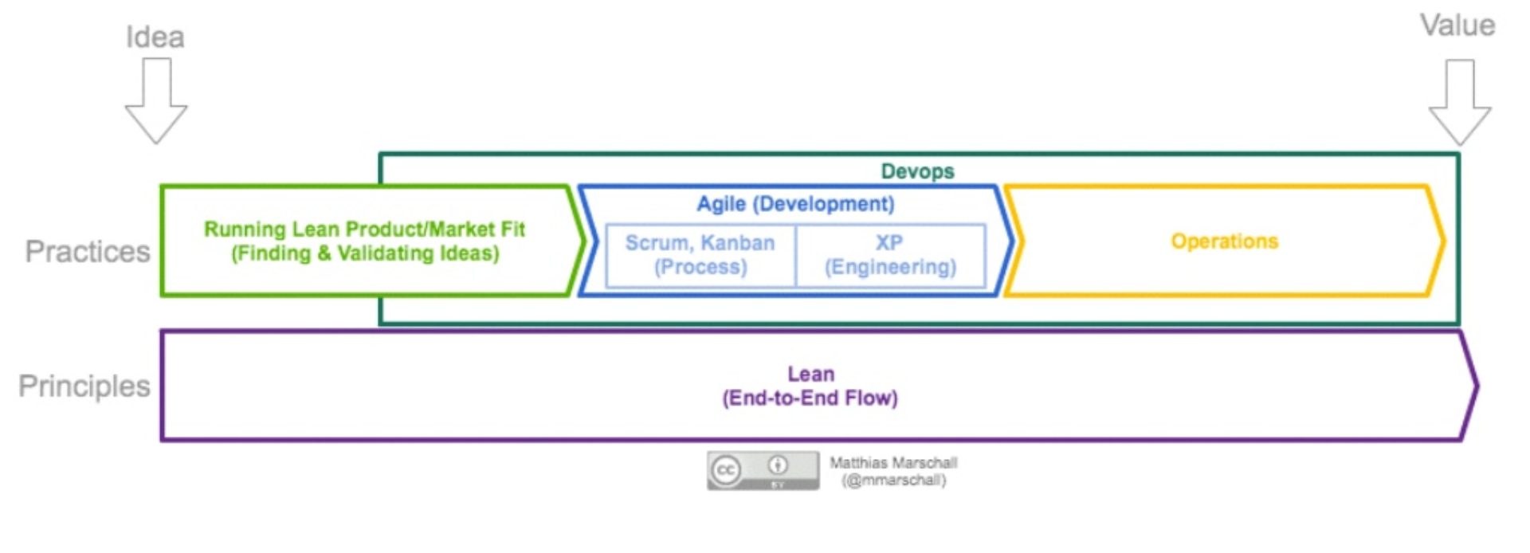
DevOps: Agile & Lean to Operations Work
DevOps: a practice of operations and developments engineers participating together in the entire service lifecycle from design through development process to production support
Source: https://theagileadmin.com/what-is-devops/

Slide 28
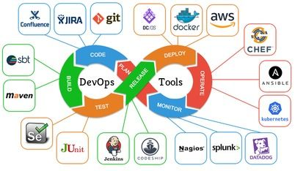
DevOps and Tools
DevOps is a set of practices that emphasizes the collaboration and communication of both software developers and other information technology (IT) professionals, while automating the process of software delivery and infrastructure changes, its implementation can include the definition of the series of tools used at various stages of the lifecycle
There is no one product that can be considered a single DevOps tool
Source: https://dzone.com/articles/an-agile-introduction-to-devops-what-is-devops-any

Slide 29
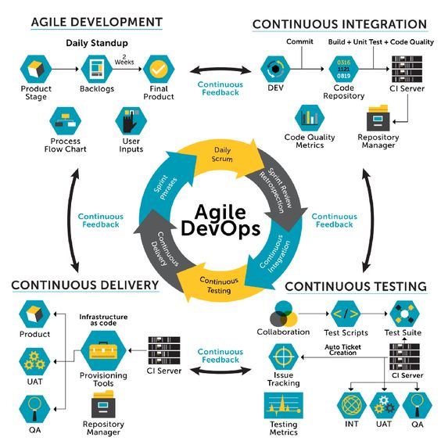
Agile DevOps…
Agile along with DevOps has a collaborative working style, irrespective of the method implemented
Both the methodologies rely on continual feedback and routine updates about the work progress from internal and external stakeholders
Both Agile and DevOps focus on developing the product at a fast pace, by keeping smaller teams and using a risk-free approach
Both methods adapt to the business requirements and continually improve the products to fulfill customer expectations
https://www.educba.com/agile-devops/

Slide 30
Agile DevOps
Agile DevOps is an extended agile methodology for product development where DevOps is a succession to agile and not a replacement
In a nutshell, Agile works towards software development by making continuous alterations, adapting and developing products as per customer expectations
While DevOps through automated processes and bug detection at an early stage of software development focusses primarily on deploying products of high quality
Source: https://www.educba.com/agile-devops/

Slide 31
Summary
Design by Contract
  bridges the gap between formal correctness proofs and writing code without any specification
  shall be used to specify interfaces
  validates contracts at run-time
  does not obviate the need for tests
  supports to implement “correct” programs
  does not support the robustness of programs
Defensive Programming
  is needed for product-quality programs
  supports the robustness of programs
  makes code larger and sometimes more complex

Slide 32
References
Java Tutorial: Programming with Assertions.
http://java.sun.com/j2se/1.4/docs/guide/lang/assert.html
Java Boutique: Assertions in Java.
http://javaboutique.internet.com/tutorials/assertions/
Sample chapter on assertions in Java.
http://www.ii.uib.no/~khalid/pgjc/jcbook/JC2_Ch05-assertions-excerpt.pdf

